Slide 1

Civic Hacking in Chattanooga
Jason Denizac
Code and Creativity

Slide 2

Notes:
I’m a web developer, a writer, and a fellow with Code for America

Slide 3
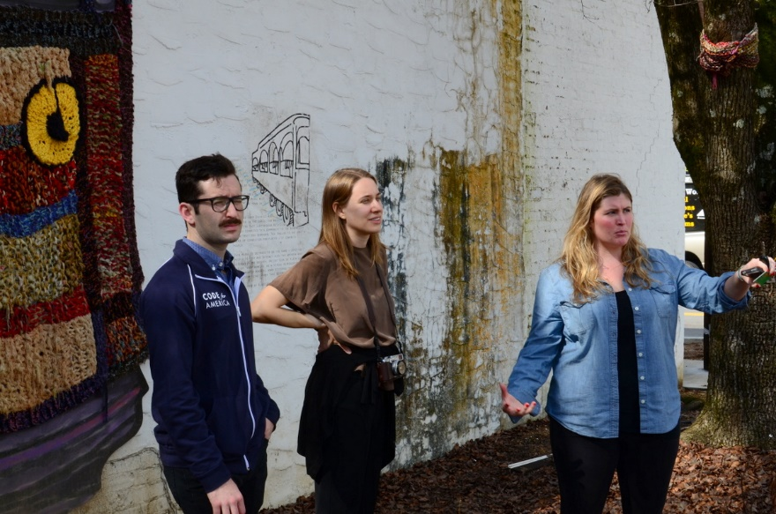

Slide 4

“Civic Hacking”
Notes:
you might be a civic hacker if, when you see a problem, you work to help make it better, instead of just complaining about it

Slide 5

Carrot
Notes:
is this just citizenship? are we inventing new words for old things? isn’t this all a bit ridiculous?

Slide 6
Public Data
Notes:
these are things like freedom of information act requests for data from police response times to park locations, public meeting minutes, and yes, bus schedules

Slide 7

credit: DRs Kulturarvsprojekt via wikimedia commons

Slide 8
Public Data
Notes:
these are things like freedom of information act requests for data from police response times to park locations, public meeting minutes, and yes, bus schedules

Slide 9
Open Data

Slide 10
Open Data
useful, available

Slide 11
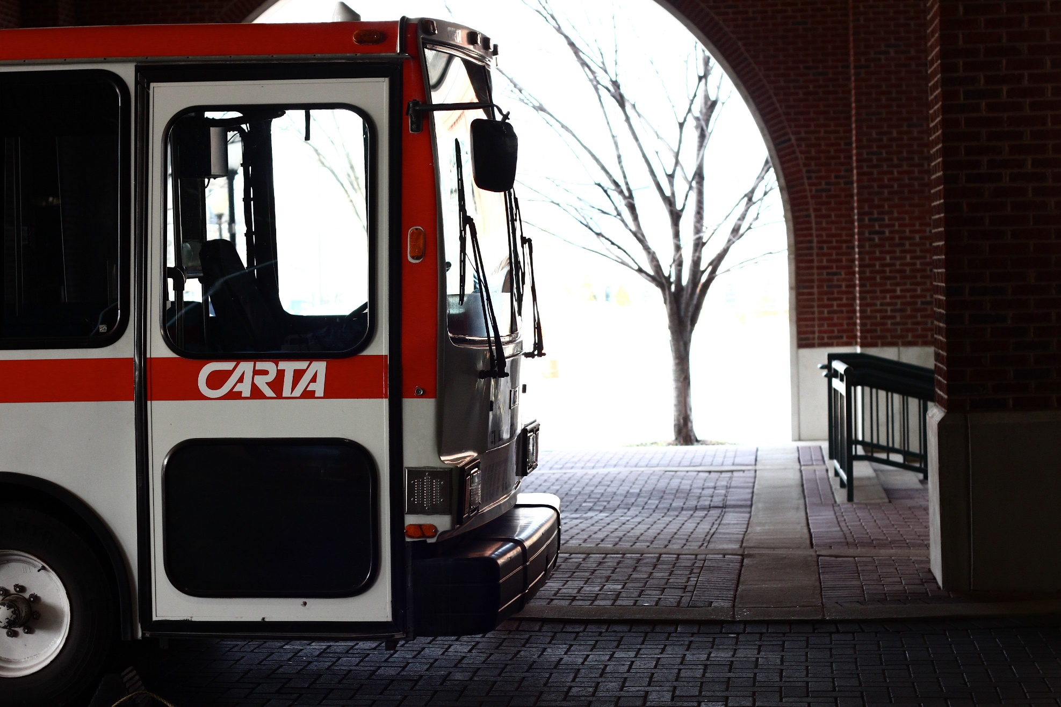
Riding the bus
credit: CARTA

Slide 12
50% earn under $15,000
public transit is critical to Chattanoogans’ daily lives

Slide 13
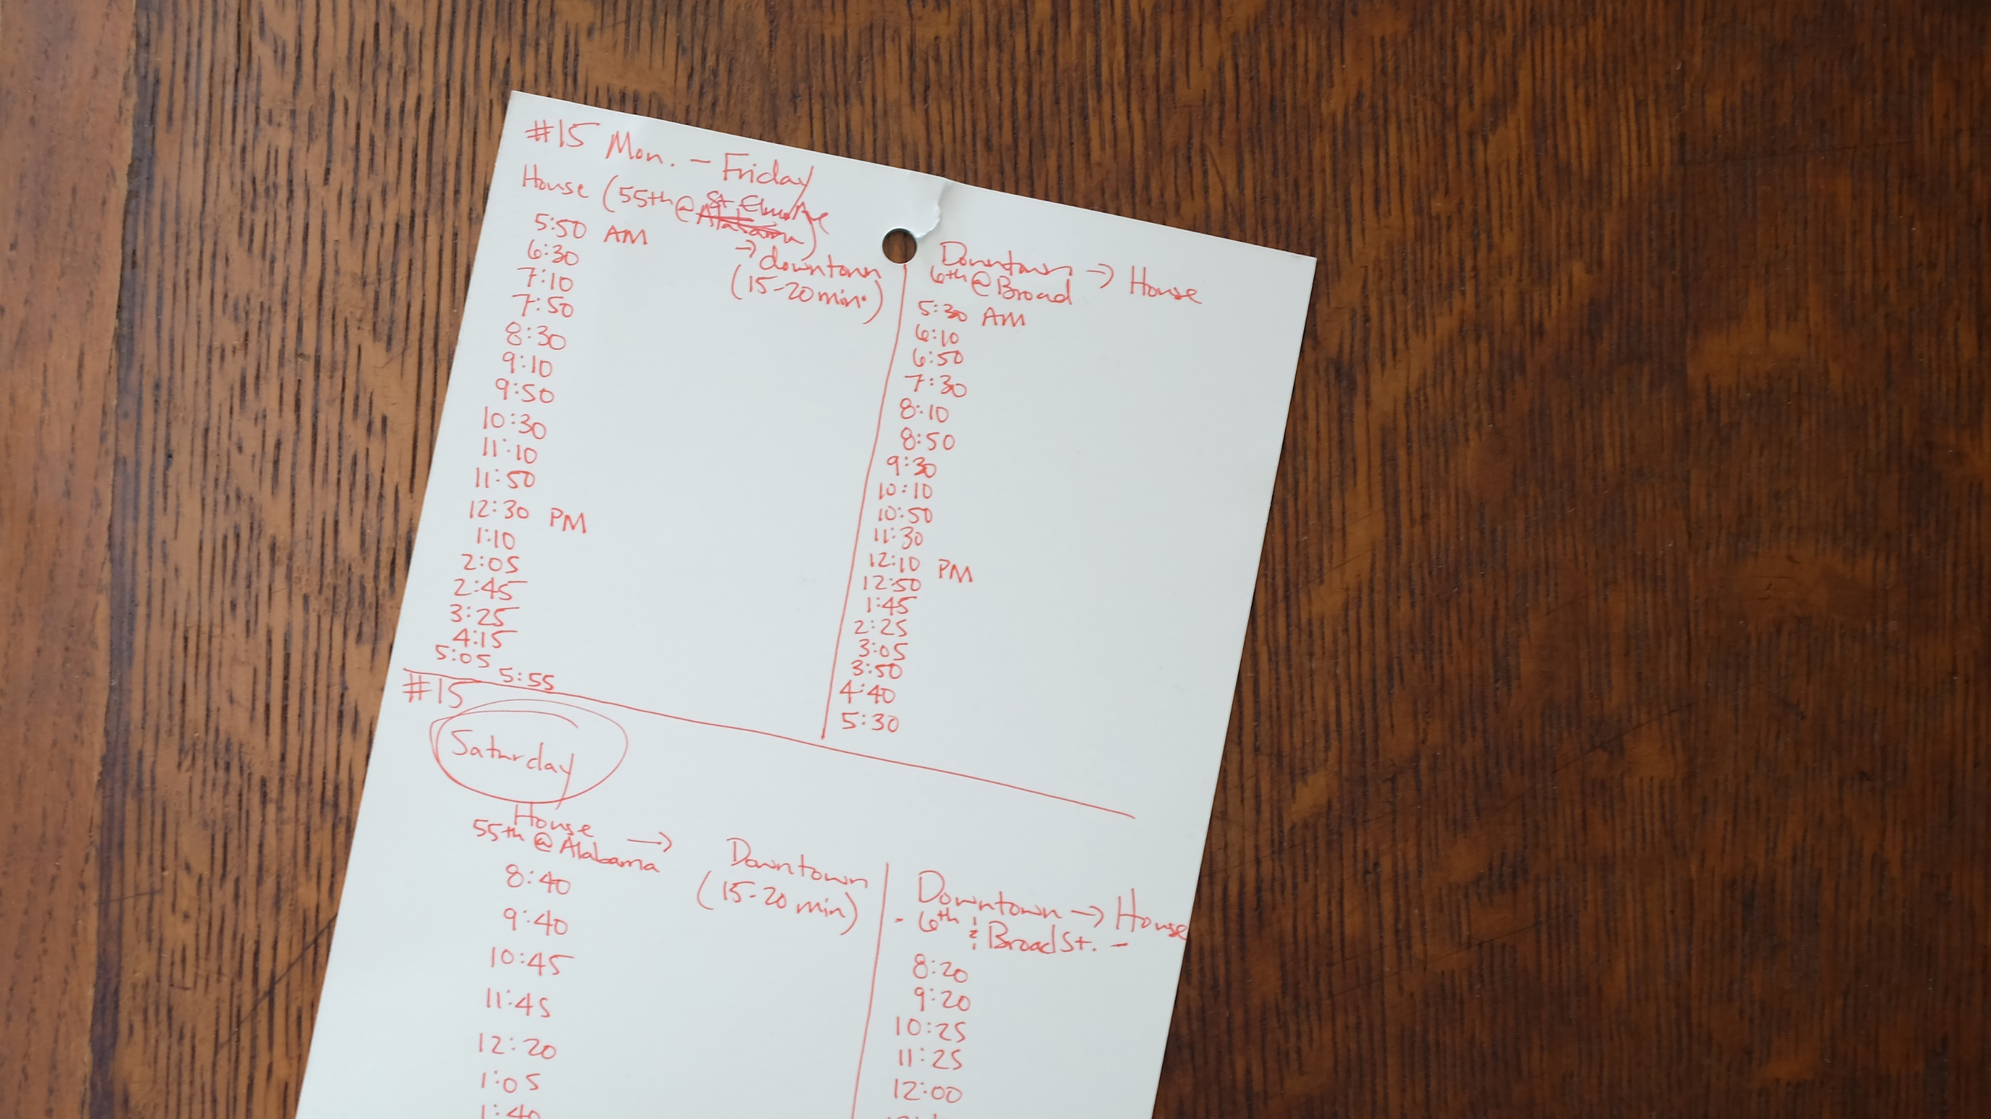

Slide 14
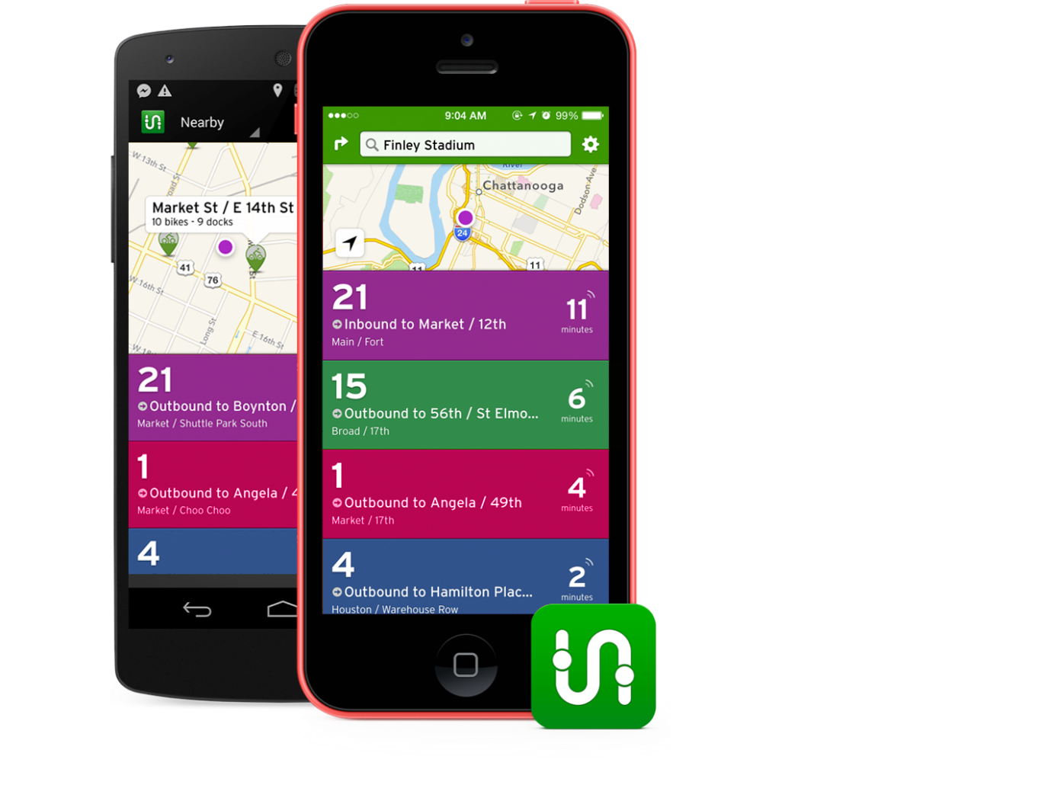

Slide 15
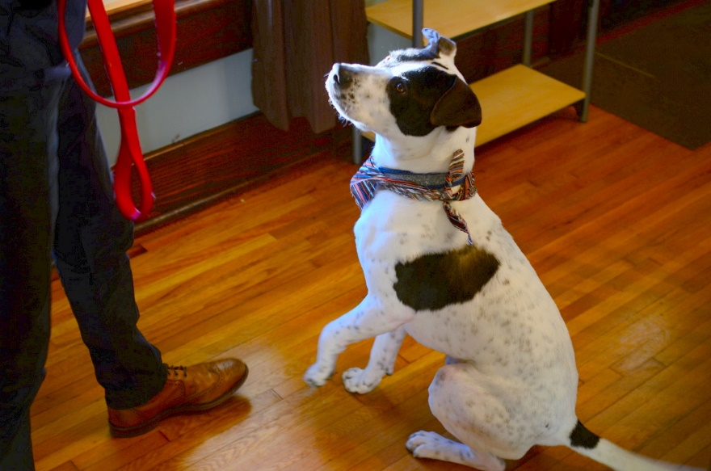
@CutePetsCHA

Slide 16
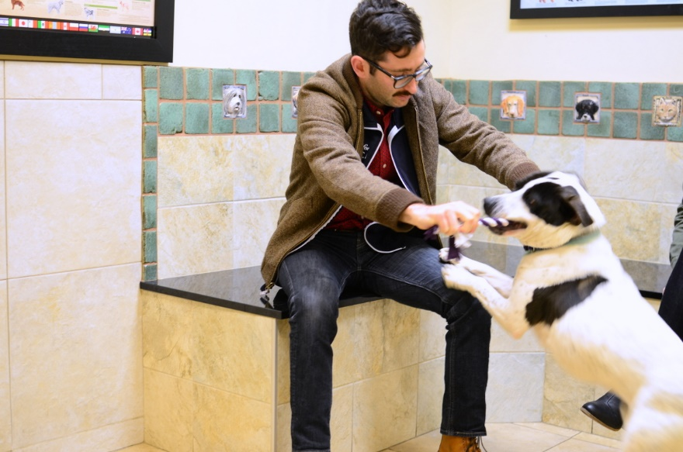

Slide 17
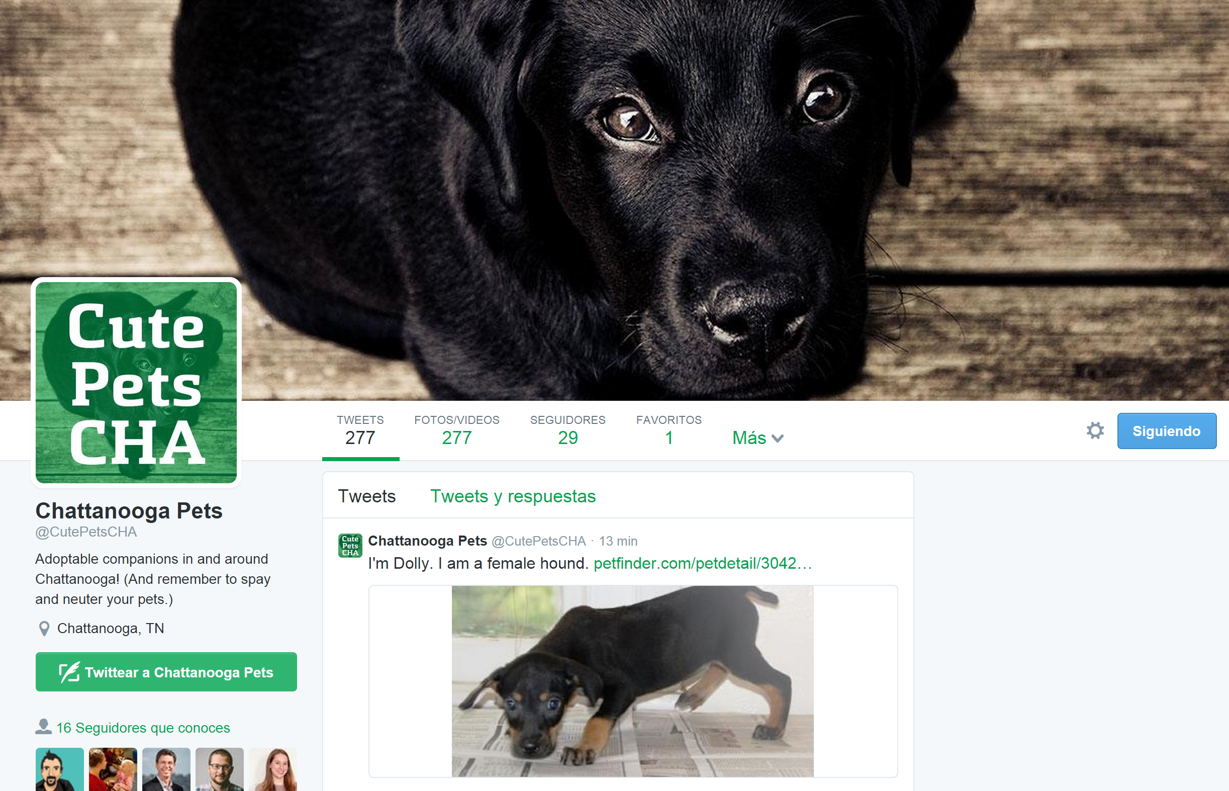

Slide 18
Get involved
openchattanooga.com
@openchattanooga

